Slide 1
Governmentwide Commercial Purchase Card Policies and Directives OUSD(A&S)/DPC/CeB Ms. Denise Reich and Ms. Sheila McGlynn

Slide 2
Agenda
Defense Pricing and Contracting (DPC) Website: Governmentwide Commercial Purchase Card (GPC) Webpages and Training
DoD SmartPay® 3 (SP3) GPC Governance Update
DoD Governmentwide Commercial Purchase Card Program Policy
DoD SP3 Recently Released Policies and Related Systems Information
DPC SP3 Tools
DoD SP3 Oversight
What’s On the Horizon
Questions
Backup
Commercial Platforms Proof of Concept
Systems Website Page
SP3 Transition Information Website Page
Confirmation Bias
Dispute Management Update
DoD GPC Program Policy – Best Practices
Policy Memorandums
eCommerce Platforms Pilot – Risk and Policy
889 and ETO Purchase Log Reporting Requirements
DPC SP3 Tools

Slide 3
Defense Pricing and Contracting Website: Governmentwide Commercial Purchase Card Webpages and Training

Slide 4
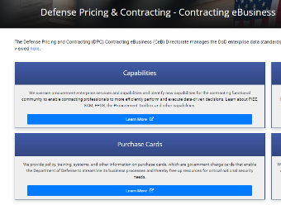
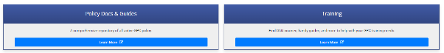
Index of GPC Webpages
Index of GPC Webpages
Access the DPC Index of GPC webpages at https://www.acq.osd.mil/asda/dpc/ce/pc/index.html.
1
From the DPC – Contracting eBusiness (CeB) webpage, select "Learn More" under “Purchase Cards” to display the GPC index.
From the GPC index, go to "Policy Docs & Guides” to see DoD GPC Program policy memos, Guidebook, 2022 DoD GPC Charge Card Management Plan, and related documents.
From the GPC index, go to "Training” to see DAU GPC Courses, Training & Requirements, DoD-level GPC Policy Available/ Recommended Training, and GPC Program One-Pagers.
2
3

Slide 5
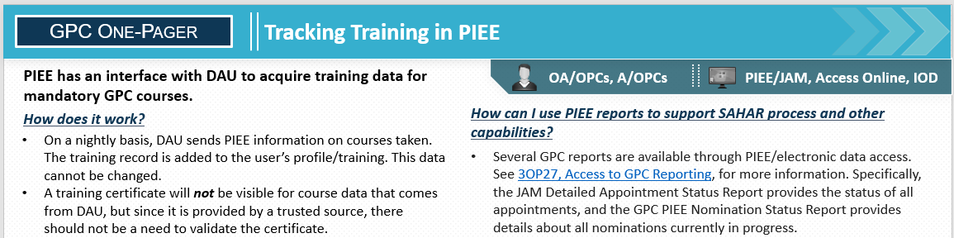
New One-Pagers
DPC is pleased to announce that several new one-pagers have been published since the 2022 GSA SmartPay Virtual Training Forum:
3OP038, Tracking Training in PIEE
3OP039, Unique Entity Identifiers for GPC Reporting to FPDS
3OP040, Running Detailed JAM/GPC Reports in EDA
3OP041, Using the Access Online PTQ (PTQ Part 2)
Find them on the GPC Training webpage: https://www.acq.osd.mil/asda/dpc/ce/pc/training.html

Slide 6
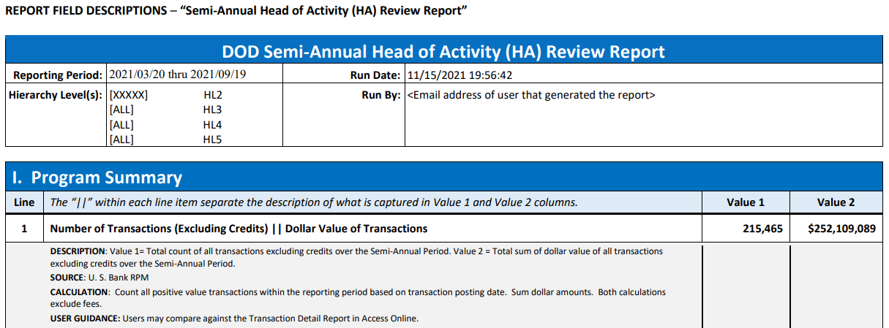
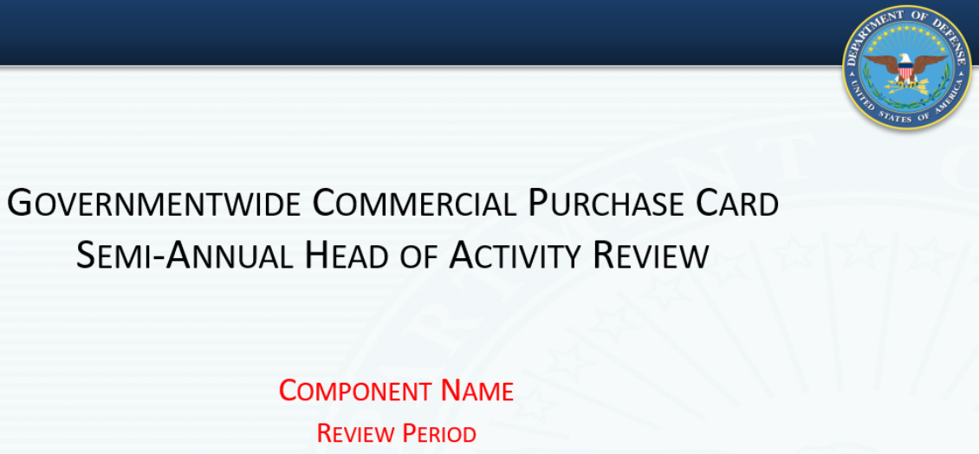
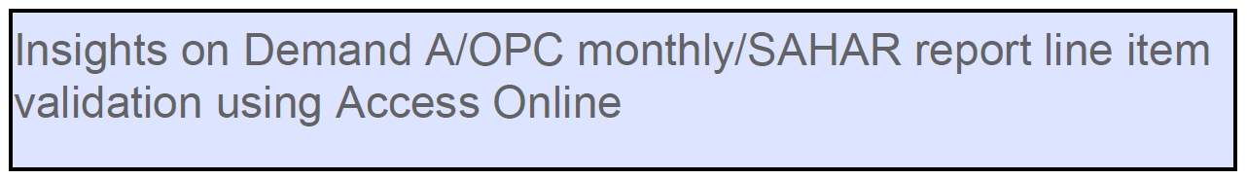
Semi-Annual Review Resources
Other valuable resources on the GPC Training webpage at https://www.acq.osd.mil/asda/dpc/ce/pc/training.html
Use the Semi-Annual Head of Activity Review Report Guide to prepare your Semi-Annual Head of Activity Review (SAHAR) Report submission.
Use the Semi-Annual Head of Activity Review Template as a framework to streamline preparation of the required Semi-Annual Head of Activity Review briefing for your Head of Activity.
Use the Insights on Demand A/OPC Monthly/SAHAR Report Line Item Validation Using Access Online (Common Access Card (CAC)-enabled) to ensure you appropriately validate reporting data.

Slide 7
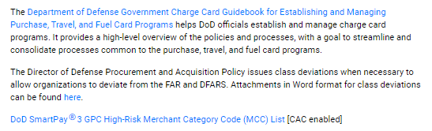
Other Resources
Other valuable resources on the GPC webpages:
Merchant Category Codes
Use your CAC to access the DoD SmartPay® 3 High-Risk Merchant Category Code (MCC) List at
https://www.acq.osd.mil/asda/dpc/ce/pc/docs-guides.html
Purchase Log Data Standard
To improve purchase log data quality, compliance, and oversight, CeB is updating the mandatory purchase log data standard established in SP3 Transition Memo #6. This:
Will support consistent Department-wide reporting, data integrity, and auditability.
Is the Phase 2 effort addressed in our DPC “Governmentwide Commercial Purchase Card Guidance Related to Recording 889 Designation and Emergency-type Operation Values (GPC 2022-02)” memo.
Resources available at our CAC-enabled page: ASD(A) - DPC - Contracting eBusiness (osd.mil)

Slide 8
DoD SP3 GPC Governance Update

Slide 9
DoD SP3 GPC Governance
Integrated Solutions Team (IST)* focus during initial years of SP3:
Making decisions to minimize Data Mining (DM) reviews of low-risk transactions by adjusting DM rules/parameters based on transaction risk and introduction of artificial intelligence.
Decreased Flagging Rate (dispositioning fewer, primarily high-risk cases)
Increased True Positive Rate (TPR) (percent of cases where the reviewer found program non-compliances)
Mitigated Confirmation Bias (tendency to assume that virtually all cases reviewed are compliant)
Initiated planned overhaul of the DM case questionnaire
Progress in FY22/FY23
Approved updates to the mandatory purchase log data standard established in SP3 Transition Memo #6 to support consistent Department-wide reporting, data integrity, and auditability. This is the Phase 2 effort addressed in GPC memo #2022-02.**
Implemented the new 250:1 span of control ratio for Cardholder (CH) and Managing Accounts to Agency/Organization Program Coordinator (A/OPC) (previously 300:1) with biennial reevaluation; added flexibility for Component Program Managers (CPMs) to deviate on a case-by-case basis for specific locations provided sufficient local oversight and compensating controls.
Approved several updates to DM rules to further increase targeting of high-risk transactions.
*GPC IST Governance Board is composed of representatives from DPC/CeB, DCMA, the Services, and Other Defense Agencies (ODAs)
Supported by the Bank Team – U.S. Bank ((Bank) card-issuing bank, Mastercard (card association), and Oversight Systems (DM vendor)
Typically meets semi-annually to review trends, identify and approve any adjustments to the Bank Team’s electronic capabilities, DoD’s GPC enterprise tools, DoD GPC policies, and the DM rules.
**“Governmentwide Commercial Purchase Card Guidance Related to Recording 889 Designation and Emergency-type Operation Values (GPC 2022-02)”
9

Slide 10
Where We Are Headed
Access Online’s Order Management:
Implementing the Purchase Log data standard
Insights on Demand (IOD) DM:
Continuing IST review and possible approval of targeted, data-driven updates to DM rules and parameters to further increase targeting of high-risk transactions
Continuing to work with the IST to finalize updates to the DM questionnaire
Enabling employee-centric learning soon
Updating to IOD version 9 for a new look/feel, faster data processing, and improved user experience
Continuing to use scheduled training events for new users/users changing roles in the program
Evaluating alternatives to meet the requirement for bi-annual ethics training
10

Slide 11
IOD - True Positive Rate (TPR) Across DoD
Fiscal Year | Army | DAF* | DON* | ODAs | DoD
FY21 – Numbers provided by the Bank Team last year | 14.50% | 7.82% | 3.81% | 27.78% | - -
**FY21 – Numbers corrected by the Bank Team | 11.13% | 5.91% | 2.67% | 21.45% | 8.24%
FY22 | 9.66% | 6.84% | 2.82% | 20.14% | 8.09%
Change (using corrected FY21 numbers) | -1.47% | +.93% | +.15% | -1.31% | -.14%
DoD’s TPR held relatively steady from FY21 to FY22 with a slight decrease from 8.24% for FY21 to 8.09% for FY22.
Higher TPRs indicate reviewers are finding program non-compliances at a higher rate when reviewing and closing cases.
This increases the likelihood that reviewers will be more attentive when conducting reviews.
Results in better use of reviewers’ time.
Proactive actions are being taken to improve the TPR:
IST actively manages the DM rules and process to focus adjudicators’ attention on high-risk cases.
Agency Program Management Office (PMO) performs analysis, makes recommendations, and provides additional active management and oversight.
*DAF – Department of the Air Force; DON – Department of the Navy
**FY21 TPR depicted in DPC’s 2022 Directives brief contained inaccuracies based on Bank Team-provided data. The FY21 TPRs have been adjusted to accurately depict this data. Oversight Systems attributes last year’s inaccuracies to manual errors associated with the data pull and “to cases reopened or manually created and different account of transactions on the managing account.”
11
11

Slide 12
Streamlining Communications
Using email streamlines communications. In Access Online, there are three areas where a CH email address may be entered. An email address may be entered by the:
A/OPC when the user ID, password, and hierarchy assignments are established.
A/OPC when the CH Account is created/edited in "Account Administration." This is the only email address the Bank will use to request CH documentation for a dispute.
Note: The CH email in the Procurement Integrated Enterprise Environment (PIEE) Task Queue (PTQ) transfers to Account Administration only if the A/OPC takes action on the task in the PTQ by accessing each associated account.
CH in the "My Personal Information" area of their account in Access Online. CHs can ensure they are notified when the status of an existing dispute changes by updating "My Personal Information" in Access Online. Details are provided in the Dispute Management slides that follow.

Slide 13
Dispute Management Update

Slide 14
Dispute Management Update
Components reported increases in disputes ruled “In Favor of Merchant” when compared to SP2 data.
Review of SP3 dispute data for the period 4/01/2021 through 7/31/2022 revealed an unexpectedly high percent of cases determined in favor of the merchant:
38% in favor of CH (10% decrease from comparison period in SP2, excluding DON)
57% in favor of merchant (8% increase, excluding DON)
5% unresolved
Potential reasons for high dispute resolution in favor of merchant:
CHs dispute transactions inappropriately
CHs do not provide dispute supporting documentation to the Bank or do not provide it timely
CHs dispute transactions to cover up fraud and other suspect behavior
Items 1 and 2 require additional CH training. They are addressed on the next slide and in Backup slides.
For Item 3, the IST governance board has approved updates to the DM questionnaire to better account for disputes, focusing on adjudication of the most risky disputes (those ruled in favor of the merchant).
Improvements to dispute management will likely result in financial and other benefits to both the Government and the Bank.

Slide 15
Dispute Management Update, Cont.
Most issues can be resolved if the CH contacts the vendor directly. This contact usually results in the vendor providing a credit to correct the issue, or the CH remembering they did, in fact, authorize that transaction.
Any direct vendor contact resulting in a satisfactory outcome for the Government makes a dispute with the Bank unnecessary.
If the CH deals directly with the vendor and does not obtain a satisfactory outcome, a dispute with the Bank should be initiated as soon as possible after the transaction date, but no later than 90 days from the date of transaction.
15

Slide 16
Dispute Management Update, Cont.
The Bank will not send a communication to acknowledge receipt of a dispute.
However, if supporting documentation is needed, the Bank will send a letter acknowledging the dispute and requesting documentation within a certain number of days from the letter date.
During COVID, the Bank enabled use of email to request additional dispute documentation when required (using the Account Administration email address in Access Online) instead of paper communication. The bank will typically use email, but only when a valid email address is available in Account Administration. Otherwise, correspondence will be sent via USPS mail.
CHs can enable email notification for Dispute Status Changes via My Personal Information in Access Online.
Would provide notifications when the status of an existing dispute changes. This would help ensure the CH is aware of whether the dispute was found in favor of the vendor or the CH.
The CH must access “My Personal Information,” enter their email address, navigate to “Email Notifications,” and select the radio button for “Dispute Status Email Notification.”
CHs must have a valid email address in Access Online’s Account Administration to receive dispute documentation correspondence via email.
CHs may enable email notifications for Dispute Status Changes via Access Online’s My Personal Information
For details and a thorough review of the current dispute process, see Backup slides.
16
16

Slide 17
DoD Governmentwide Commercial Purchase Card Program Policy

Slide 18

DoD GPC Program Policy
Forthcoming GPC-unique guidebook titled DoD Governmentwide Commercial Purchase Card Program Policy (DoD GPC Program Policy)
Targeting release in Calendar Year 2023 (CY23)
Goal is to help GPC program participants establish, manage, operate, and oversee DoD GPC programs
Will incorporate and codify all DPC GPC policy memoranda released since the last issuance, plus best practices
Other charge card programs (i.e., Defense Travel Management Office’s Government Travel Charge Card and the Defense Logistics Agency Energy’s Government Fuel Card Program), have their own separate policies and instructions

Slide 19
DoD SP3 Recently Released Policies and Related Systems Information

Slide 20
Recently Released Policies
Recently Released Policies
All GPC policy memos are available at: https://www.acq.osd.mil/asda/dpc/ce/pc/docs-guides.html
Details are in Backup slides

Slide 21
Recently Released Policies
Summary of Recently Released Policies
Governmentwide Commercial Purchase Card Guidance Related to Recording 889 Designation and Emergency-type Operation Values (GPC 2022-02), June 29, 2022 Mandates use of a new Access Online capability that validates CHs have made a selection from a drop-down picklist of valid values for specified purchase log fields before they can approve their monthly billing statement. It also expands the 889 Designation List of allowable entries established in the OUSD(A&S)/DPC memorandum "Recording Implementation of Section 889(a)(1)(B), Prohibition on Contracting with Entities Using Certain Telecommunications and Video Surveillance Services or Equipment, when Using the Governmentwide Commercial Purchase Card."
Guidance on the Planned Intra-Governmental Transaction Limit Decrease Effective October 1, 2022 (2022-03) Effective October 1, 2022, the Intra-Governmental Transaction (IGT) limit was reduced from $24,999 to $10,000. This change necessitates redirecting IGTs exceeding $10,000 formerly processed using a GPC to an alternative payment method, requiring GPC CPMs and A/OPCs to engage with their supporting Comptroller Offices to implement necessary policies and procedures in support of the threshold reduction.
Governmentwide Commercial Purchase Card Third-Party Payment and Non-Department of Defense E-Commerce Platforms Policy (GPC 2023-01) This memorandum updates GPC third-party payment policy and establishes policy for Components seeking to make purchases using non-DoD e-commerce platforms.
21

Slide 22
Recently Released Policies, Cont.
Summary of Recently Released Policies
Prohibition on Use of the Governmentwide Commercial Purchase Card When Contracts Contain Federal Acquisition Regulation Clause 52.229.12, Tax on Certain Foreign Procurements (2023-02) Effective November 8, 2022, GPC CHs shall not use the GPC as a method of payment or purchase when a contract instrument contains Federal Acquisition Regulation (FAR) clause 52.229.12, unless Defense FAR Supplement clause 252.229-7014, “Full Exemption from Two Percent Excise Tax on Certain Foreign Procurements” is also present. This memorandum supersedes the DPC memorandum “[GPC] Interim Use Prohibition When Contracts Contain [FAR] Clause 52.229-12, Tax on Certain Foreign Procurements (GPC 2021-2),” dated November 5, 2021.
Governmentwide Commercial Purchase Card Prohibited Purchases (GPC 2023-03) This memo, which applies to GPC open-market micro-purchases, implements section 333 of the William M. (Mac) Thornberry National Defense Authorization Act for Fiscal Year 2021 (Pub. L. 116-283) that prohibits DoD from procuring any covered items containing Perfluorooctane Sulfonate (PFOS) or Perfluorooctanoic Acid (PFOA) effective April 1, 2023. It adds all nonstick cookware or cooking utensils for use in galleys or dining facilities, and upholstered furniture, carpets, and rugs that have been treated with stain-resistant coatings, to the list of DoD GPC prohibited purchases. It also addresses GPC uses other than open-market micro-purchasing to obtain covered items that do not include PFOS and PFOA and advises Components to issue policy to enhance compliance.

Slide 23
Single Sign-On
DoD GPC policy mandates use of PIEE Single Sign-On (SSO) to the Bank’s Access Online and IOD.
Use of CAC-based authentication improves internal control compliance by:
Enabling system validation that necessary appointments have been issued
Ensuring accounts are associated with only known, appointed individuals who are uniquely identified by their DoD ID / Public Key Infrastructure (PKI) to reduce the risk of fraud and misuse
Reducing the risk of accounts being created from, or accessed by, individuals who have not been subjected to the rigorous review necessary to obtain a CAC
Capitalizing on the initial and recurring access control protections / validations realized with Government Administrator (GAM) and Supervisor account approvals
Reducing the risk of multiple individuals sharing / fraudulently using a single username and password
Between March 2022 and January 2023, all but one Component enabled Component-wide SSO use.
23

Slide 24
Working Groups and Implications for Purchase Log

Slide 25
GPC Working Groups
DPC has convened various working groups (WGs), responsive to the GPC community’s needs.
Members of the WGs are subject matter experts (SMEs) with extensive experience using GPC systems to perform DoD and Component processes.
CeB issues data calls to solicit volunteers for WGs. Anyone who is interested in participating should let their CPM know and the CPM will notify CeB.
We have three ongoing WGs, each with a Government owner:
Purchase Log: Ms. Pamela Talbott-DCMA*
GPC Systems Development: Ms. Denise Reich-DPC
GPC Advana Dashboard/Reporting: Ms. Sheila McGlynn-DPC
25
*For details on this effort, attend the Electronic Systems Update sessions on June 14 at 12:30 and 2:00.

Slide 26
Purchase Log Working Group
DPC convened this WG to standardize Purchase Log fields in the Bank’s Access Online to support consistent Department-wide reporting, data integrity, and auditability. This WG has led to the following recently implemented and pending capabilities:*
Transaction Management (TM) – custom purchase log 889 and Emergency-Type-Operations (ETO) drop-down lists – SUCCESSFULLY IMPLEMENTED on 7/1/2022
FY23/24 – Order Management (OM) – Configuration Item (CI) 225 – to implement Purchase Log Data Standard with multiple Custom Fields – PENDING
Will include 20 custom fields and 10 line-item custom fields that can be configured by DoD and Components
Will be a combination of drop-down (889, ETO, and others) and free form text fields
Once implemented, policy will be updated – addressed on the next slide
Existing TM, plus pending OM capabilities:
Promote compliance by increasing use of intuitive drop-downs
Improve data integrity and analytics capabilities
Support decision-making
*For details on this effort, attend the Electronic Systems Update sessions on June 14 at 12:30 and 2:00.
CHs use Access Online’s OM to enter Purchase Log information.
CHs use TM to view vendor-provided transaction data, reconcile transactions, retain transaction-supporting data, and approve statements.
OM and TM are configured to work in concert to ensure the monthly reconciliation process cannot be completed before each transaction is matched to an order.
26

Slide 27
Purchase Log Requirements*
889: CHs are required to record specific 889 purchase log designations for all purchase card transactions.
Access Online data reveals significant compliance issues – see Backup slides for details.
Recent Access Online TM and pending OM enhancements will be leveraged to improve data quality.
Applicable Policy:
DPC memo “Recording Implementation of Section 889(a)(1)(B), Prohibition on Contracting with Entities Using Certain Telecommunications and Video Surveillance Services or Equipment, when using the Governmentwide Commercial Purchase Card,” 9/9/20 required 889 purchase log text entry using allowable designations.
DPC memo “Governmentwide Commercial Purchase Card Guidance Related to Recording 889 Designation and Emergency-type Operation Values (GPC 2022-02),” 6/29/22 requires ETO and 889 purchase log entries using drop-down picklists for all transactions in TM.
Until CI 225 is implemented, CHs will continue to use 889 text entries in OM.
*This slide and the next address only compliance with 889 GPC purchase log policy requirements, as this is readily available data (displayed in Backup slides 92 and 93). For compliance with Section 889(a)(1) requirements, see FAR 4.21, DPC memos “GPC Guidance related to Implementation of the Section 889(a)(1)(B) Prohibition on Contracting with Entities Using Certain Telecommunications and Video Surveillance Services or Equipment,” 8/11/20 and “Recording Implementation of Section 889(a)(1)(B), Prohibition on Contracting with Entities Using Certain Telecommunications and Video Surveillance Services or Equipment, when using the Governmentwide Commercial Purchase Card,” 9/9/20,” and Backup slides.
27
27

Slide 28
Purchase Log Requirements, Cont.
ETO: CHs are required to enter a purchase log entry for:
All ETO transactions, when a National Interest Action Code exists
All transactions made in TM, using drop-down capabilities
Once OM enhancement is fully enabled, policy to be updated to require CHs to select an ETO purchase log entry from drop-down picklists for all purchase card transactions
Applicable Policy:
”Governmentwide Commercial Purchase Card Guidance Related to Recording 889 Designation and Emergency-type Operation Values (GPC 2022-02),” 6/29/22
“Governmentwide Commercial Purchase Card Guidance Related to Recording Transactions involving National Interest Action Codes and Emergency Acquisition Authorities (GPC 2021-1),” 12/9/20
“Department of Defense SmartPay® 3 Government-wide Commercial Purchase Card Guidance for the Coronavirus Disease 2019 (COVID-19,)” 4/2/20
Recommendations for 889 and ETO:
Approving/Billing Officials (A/BOs) must validate sufficiency of purchase log entries when reconciling
A/BOs and A/OPCs must monitor during DM case dispositions

Slide 29
GPC Advana Dashboard/Reporting
With the impending move from the Procurement Business Intelligence Service (PBIS), CeB’s procurement data warehousing and reporting tool, to Advancing Analytics (Advana), CeB saw an opportunity to create the GPC Advana Dashboard/Reporting WG to benefit GPC Component programs and CeB. The WG’s objective is to utilize GPC data in Advana to develop dashboard and reporting capabilities to increase strategic and operational oversight and optimize program performance.
The WG is surveying current General Services Administration (GSA) and Bank Team capabilities, including:
GSA SmartPay Data Warehouse dashboard: https://spdatawarehouse.gsa.gov
GSA Program Statistics: https://smartpay.gsa.gov/content/program-statistics-overview
GSA Statistics/Dashboard: https://smartpay.gsa.gov/sites/default/files/StatsTool_FY21_M11_v1_EXTERNAL_4.xlsx
U.S. Bank’s Access Online Data Analytics: https://piee.eb.mil/xhtml/unauth/home/login.xhtml
Oversight Systems’ Insights on Demand (IOD) Dashboard: https://piee.eb.mil/xhtml/unauth/home/login.xhtml

Slide 30
DPC SP3 Tools

Slide 31
PIEE and Joint Appointment Module (JAM)
Procure to Pay (P2P) Training Symposium presentations available at:
https://www.acq.osd.mil/asda/dpc/ce/p2p/p2p-training-symposium.html

Slide 32
JAM GPC Appointments
DoD GPC policy mandates use of JAM to issue GPC Appointments
Ensures compliance DoD FMR, FAR, DFARS, and DoD GPC policy.
Ensures appointment access by appointee, supervisor, and GPC program officials and satisfies record retention and termination requirements.
Validates training completion prior to issuance of appointments and issues periodic reminders.
Detailed data about appointees, CH special designation authority types, GPC warrants issued, training and workflow status available in Electronic Data Access (EDA) Advanced Reporting.
Triggers automatic access to other PIEE modules such as Access Online (including IOD and Web-based Training), Supplier Performance Risk System (SPRS), FedMall, and Purchase Card Oversight Module (PCOM).

Slide 33
Cardholder Special Designations and Single Purchase Limits
Oversight A/OPC (O A/OPC) and A/OPC initiating JAM CH appointments must select the appropriate special designation(s) and designate the ceiling single purchase limit (SPL) for each.
The SPL specified on the appointment serves as the account ceiling (i.e., not-to-exceed) limit in Access Online:
The highest delegated value serves as the SPL ceiling on the account if more than one special designation is assigned to an account.
DoD’s best practices call for unique accounts to be created for each CH special designation.
A SPL or Cycle Limit of $0 cannot be entered for any special designation.
The minimum amount that can be entered is $1 because Access Online treats $0 as UNLIMITED.

Slide 34
GPC CH Special Designations
Special Designation | NTE | Grants Cardholders Authority To:
1. Micro-Purchase CH | $10K | Make purchases valued at or below the open-market micro-purchase threshold (MPT) defined in FAR 2.101, using simplified acquisition procedures.
2. Micro-Purchase Convenience Check Writer | $5K | Make authorized convenience check purchases at or below one-half the open-market MPT using simplified acquisition procedures.
3. Micro-Purchase Emergency-Type Operations CH and Convenience Check Writer | $20K / $35K | Make authorized open-market micro-purchases priced at or below the Emergency-Type Operations (ETO) MPT defined in FAR 2.101(3).
4. Higher Education Micro-Purchase CH | No Limit | Acquire supplies or services from institutions of higher education or related or affiliated nonprofit entities, or from nonprofit research organizations or independent research institutes.
5. Warranted Overseas Emergency-Type Operations CH | $1.5M | Make purchase as authorized in DFARS 213.301(3). May be granted only to contracting professionals holding an SF-1402 unrelated to GPC JAM appointments
6. Contract Ordering Official CH SF-1402 JAM WARRANT ISSUED | $250K | Place and pay for orders against Indefinite Delivery Contracts, Basic Ordering Agreements, and Blanket Purchase Agreements that have firm fixed prices and prearranged terms and conditions.

Slide 35
GPC CH Special Designations
CH Special Designations | NTE | Grants Cardholders Authority To:
7. Overseas Simplified Acquisition CH SF-1402 JAM WARRANT ISSUED | $25K | Make purchases using simplified acquisition procedures only when: CH is outside the U.S. Items/services purchased will be used outside the U.S. Purchase complies with DFARS 213.301(2) requirements.
8. Contract Payment Official CH | No limit | Make contract payments when authorized by the contract’s terms and conditions, in accordance with FAR 13.301(c)(2).
9. Miscellaneous Payments Official CH (SF-182 Training Payments) | $25K | Make payments for commercial training requests using the SF-182 in lieu of an employee reimbursement by miscellaneous payment, in accordance with the procedures to directly pay the provider in DoD FMR Volume 10, Chapter 12, Section 120323, and DoD Instruction 1400.25, Volume 410.
10. Inter/Intra-Governmental Payment Official CH | $24,999 | Make payments to another Federal Government entity in lieu of using a Military Interdepartmental Purchase Request (MIPR) or Inter-Governmental Payment and Collection (IPAC).
More information available in the JAM Roles Description Document at: https://www.acq.osd.mil/asda/dpc/ce/pc/systems.html

Slide 36
GPC Appointments Summary
JAM Warrants Issued by Role / Special Designation
March 2023 | Number | Other Information
CH with Contract Ordering Official | 12,635 | Less than $10K = 587 (4.65%) $10K to $25K = 11,127 (88.06%) Over $25K to $250K = 921 (7.29%)
CH with Overseas Simplified Acq | 3,269 | Less than $10K = 14 (.43%) $10K = 2,056 (62.89%) Over $10K - $25K = 1,199 (36.68%)
A/OPC with Delegating/ Appointing Authority | 2,236 | 76% of 2,927 total A/OPCs
O A/OPC with Delegating/ Appointing Authority | 504 | 72% of 702 total O A/OPCs
March 2023 | Active JAM Appointments
Army | 65,235
Navy | 20,898
Air Force | 42,291
4th Estate | 8,721
Total | 137,145

Slide 37
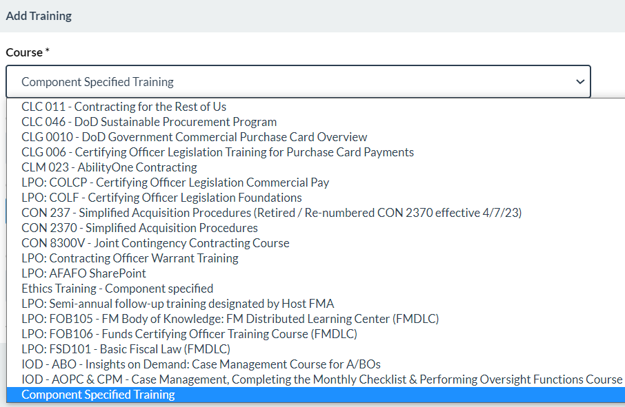
JAM Training Updates
DPC has been working with Component SMEs to address issues with tracking and reporting completion of training.
Immediate actions taken
Matched JAM drop-downs to GPC Training Webpage
Changed “Other” to “Component Specified Training”
Added Special Designation-specific selection
Short-term actions in progress
Ensuring EDA JAM GPC Training Report and associated search criteria include all listed courses
Fixing Show Current Training check box
Requested update to intuitive order for courses displayed
Working with Defense Acquisition University (DAU) and PIEE PMO to reduce days to display and report
Removed CLG 0010 transformations to CLG 001 and requested re-conversion of completions since 6/2/20
Long-term actions planned
Working Group to review related CIs and identify additional usability enhancements

Slide 38
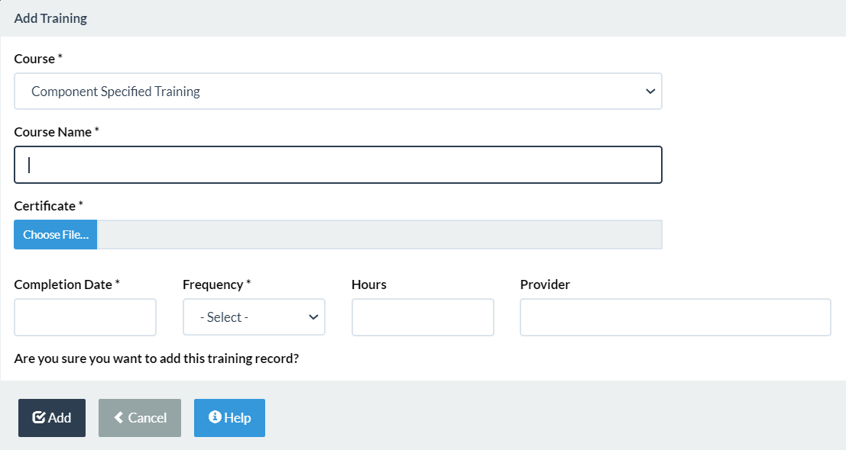
JAM Training Updates
In the short run, to further improve data quality Components may issue direction to standardized entries in the Course Name field.
Contact your CPM to volunteer for the Working Group or to participate in Engineering Change Proposal (ECP) Agile Development if you want to influence future system capabilities.

Slide 39
PIEE EDA Training Report
PIEE interfaces with DAU to acquire course completion data. This data is added to the user’s PIEE profile and used to improve internal controls by systemically validating completion of DoD-mandated training prior to appointment issuance.
PIEE/JAM allows training to be added manually to meet local training requirements.
CPMs, O A/OPCs, and A/OPCs can run reports for GPC users and appointments in PIEE/JAM using EDA. Training, nomination, and full appointment data can be retrieved.
The JAM GPC Training Report available through PIEE/EDA provides information that can be used to:
Ensure all individuals are properly trained for their role.
Complete training fields on the Monthly A/OPC Checklist and SAHAR.

Slide 40
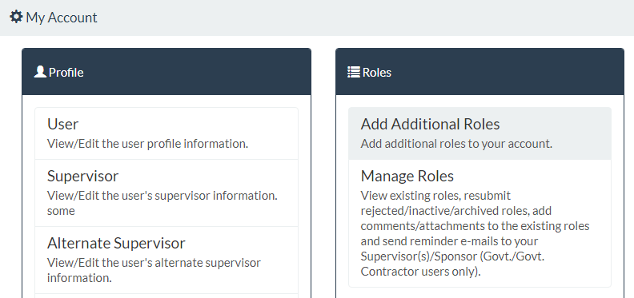
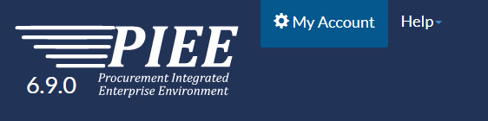
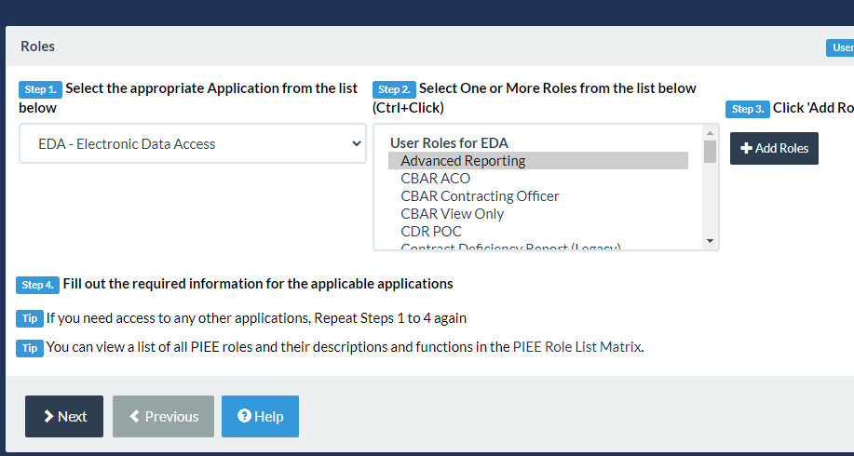
How to Get Access to PIEE/EDA Reports
Existing Users should login to PIEE
Select “My Account” on top menu
Select “Add Additional Roles” under Roles menu
Verify information on profile is accurate and progress to the roles page
Select EDA Application and the “Advance Reporting” role
The role request will flow through supervisor approval and GAM activation
40

Slide 41
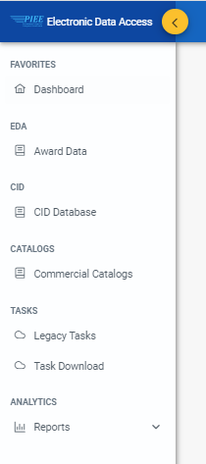
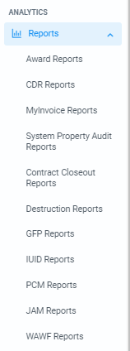
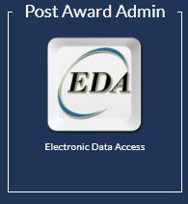
Where are EDA Reports?
Login to PIEE and select the “EDA” icon.
Once in EDA, the left-hand menu provides access to EDA capabilities.
“Reports” has a drop-down menu providing 13 categories of reporting. Each category has useful reports within that area of PIEE.
Select “JAM Reports.”

Slide 42
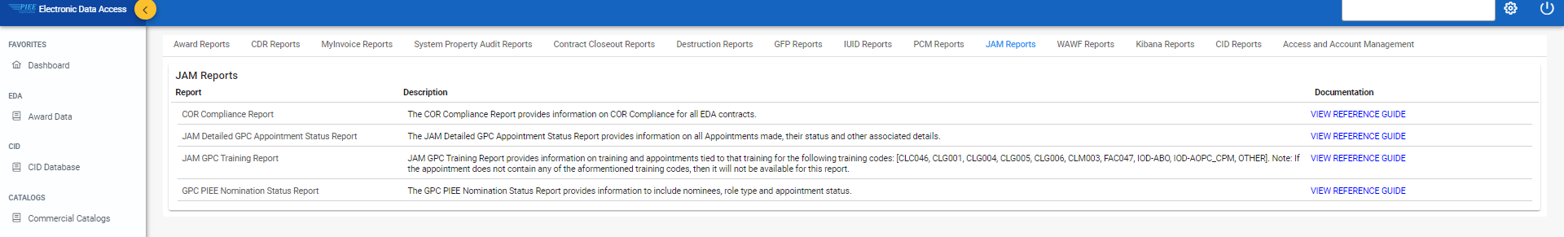
EDA JAM GPC Reports
There are currently three EDA JAM GPC reports:
JAM Detailed GPC Appointment Status Report
JAM GPC Training Report
GPC PIEE Nomination Status Report

Slide 43
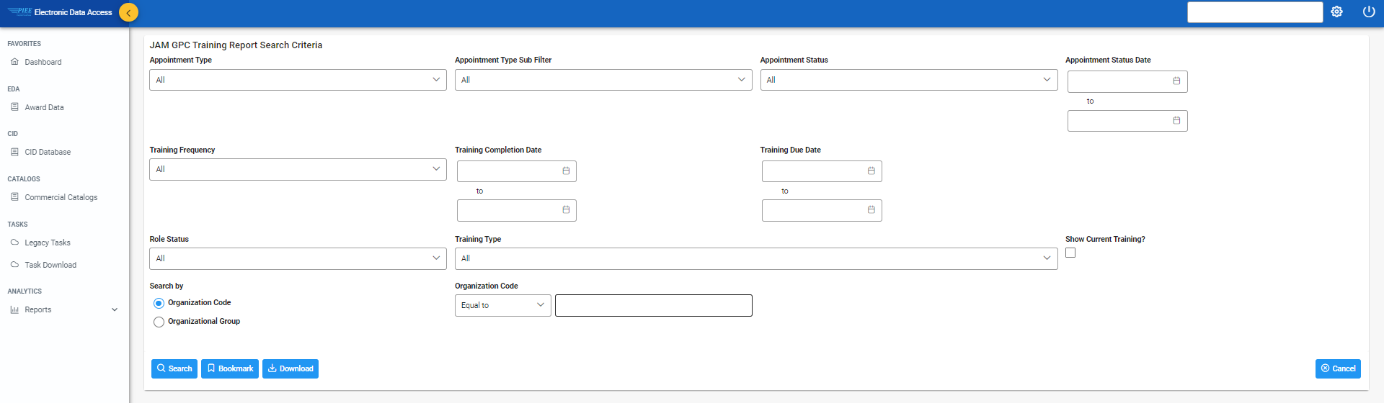
JAM GPC Training Report Search Criteria Screen
Run the JAM GPC Training Report for a particular role by defining parameters on the JAM GPC Training Report Search Criteria screen and then clicking “Search.”
The following parameters will report all active appointments for the role selected under your group:
Select the “Appointment Type”
Select “Active” Role Status
Select the “Show Current Training?” check box
Identify your organization group and subgroups as necessary
Select “Search” to run the report.
43
43

Slide 44
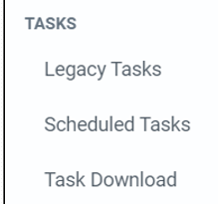
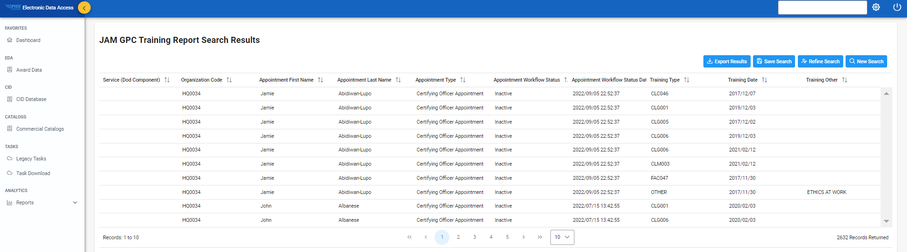
JAM GPC Training Report Search Results
Your JAM GPC Training Report Search Results display in EDA.
If the amount of data requested is large, you will need to wait while the report is prepared. Check progress and download the data from the “Task Download” menu/page.
When viewing the report in EDA, only a few summary data elements are shown and results are limited to 10,000 records.
For smaller organizations, this view may provide the information needed to complete your actions.

Slide 45

JAM GPC Training Report for Large Data Sets
Larger organizations may need to see additional data elements and the full data set to complete the Monthly A/OPC checklist, SAHAR, and other actions.
For instructions on how to do this:
See Backup slides
Refer to One-Pagers on the DPC website at https://www.acq.osd.mil/asda/dpc/ce/pc/training.html:
3OP:038 “Tracking Training in PIEE”
3OP:040 “Running Detailed JAM/GPC Reports in EDA”
Why do they call it a “One-Pager” if it is six pages long?
45

Slide 46
Data on the JAM GPC Training Report
Data on the JAM GPC Training Report
Appointment First and Last Name | Direct User First and Last Name | Training Hours
Appointment (Work Email Address) | Direct User Email Address | Training Provider (DAU, Other)
Service (DoD Component) | Direct User Type | Training Source (DAU, Manual)
Organization Code | Direct User DoDAAC | Current Row (whether it is current)
Role Status | Direct User Group | Appointment Type (PIEE Role)
Service/Org (DoD Organization Name) | Training Code | Appointment Workflow Status
PIEE Group Path of Appointee | Training Other (Name provided) | Appointment Workflow Status Date
Organization Level | Training Date | <List of all CH Special Designations>
Supervisor First and Last Name | Training Frequency
Supervisor Email Address | Training Due Date

Slide 47
Follow-Up Actions
Once the necessary reports have been generated and analyzed, follow-up actions are recommended:
For users who are not current on their training, copy the email address from the JAM GPC Training Report and send an email advising them they must complete the training and ensure the new certificate or training record is recorded in PIEE, as necessary.
The supervisor of the individual may be copied on the email by copying and pasting the supervisor’s email address (from the same report) in the message.
If you notice users on the JAM GPC Training Report that are no longer with the program, terminate their Access Online accounts if they still exist.
If you notice users in Access Online who have “Active” IDs but are no longer with the program and their appointment has been terminated in JAM, remove their user IDs immediately.
For how to’s, see Backup slides and refer to One-Pagers 3OP:038, “Tracking Training in PIEE” and 3OP:040, “Running Detailed JAM/GPC Reports in EDA” on the DPC website at https://www.acq.osd.mil/asda/dpc/ce/pc/training.html.
47

Slide 48
JAM Improvements (PIEE Release 6.11)
Deployed on February 18, 2022
Usability Focused
Streamlined Workflows
Improved Communications
Improved Internal Controls
Increased Flexibility

Slide 49
JAM Phase 4 Improvements Under Consideration
JAM Improvements Phase 4 Development work will begin shortly. Requirements under consideration are clustered in the following categories:
Reuse of existing data to streamline appointment workflows and expand access.
Automatic access to EDA based on GPC roles and special designations.
Temporarily archive PIEE roles for users with past-due training.
Training reminder emails and reporting.
Emails to support account clean up and auto termination.
Capabilities to initiate and approve bulk appointment updates.

Slide 50
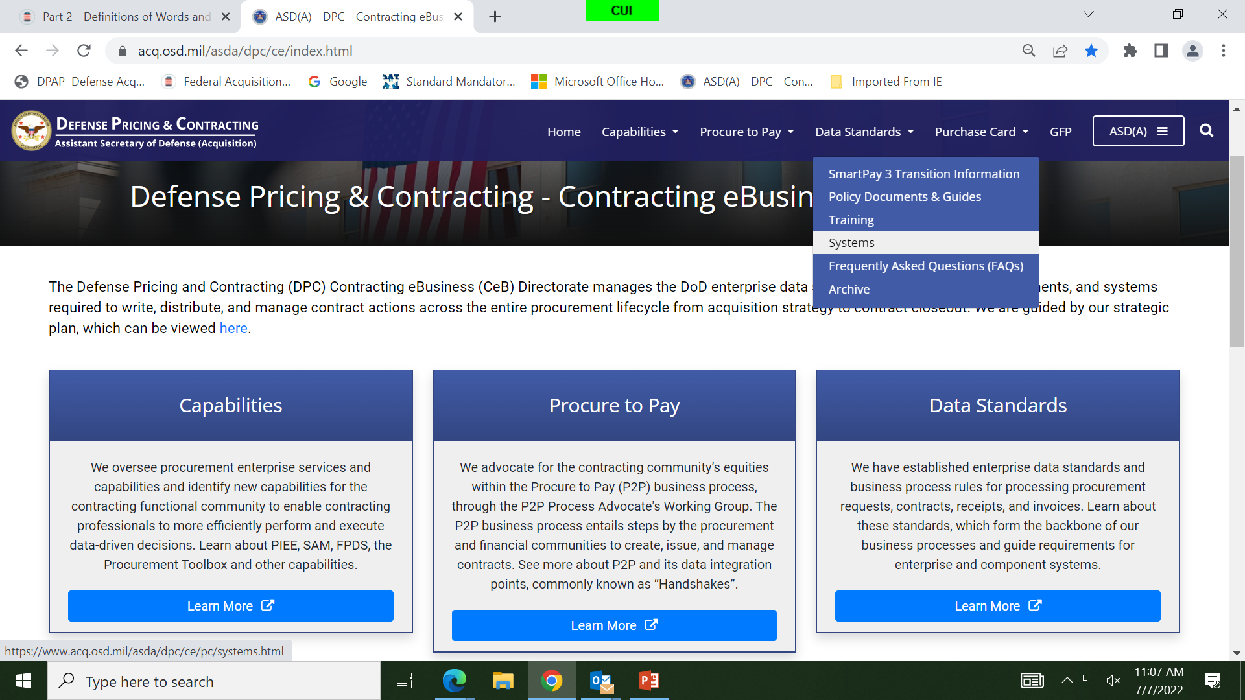
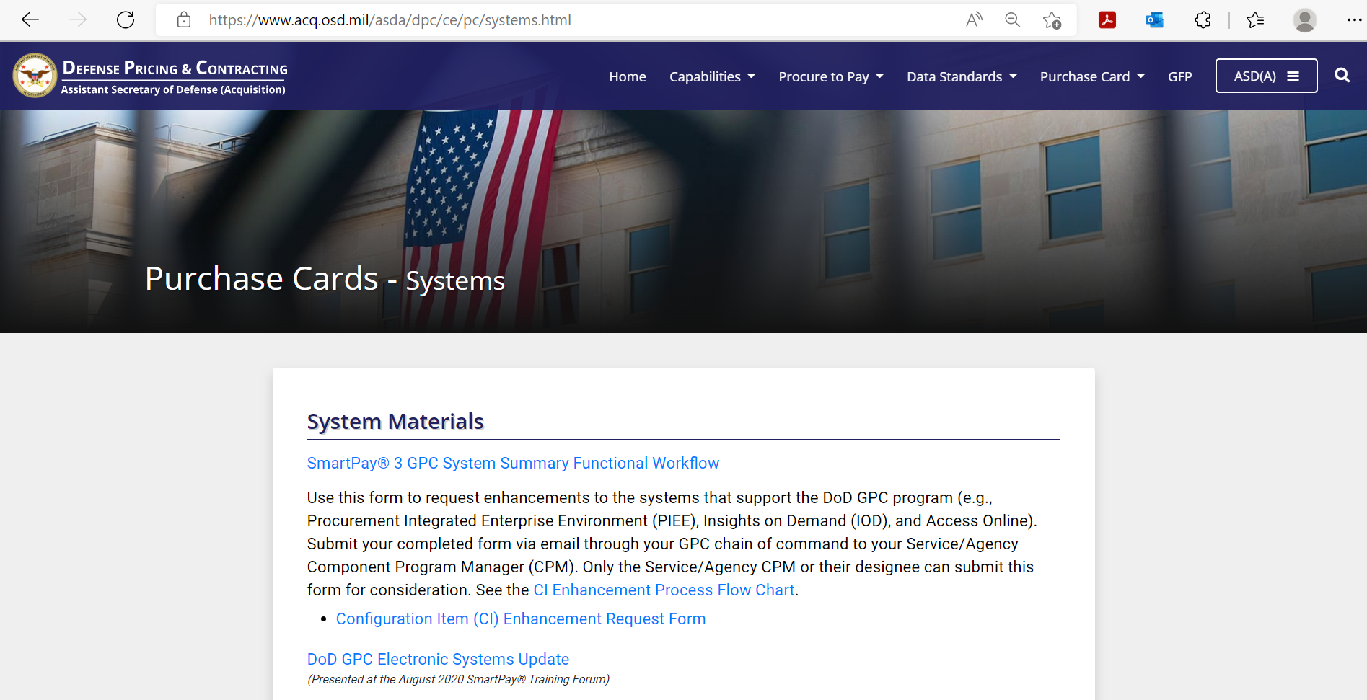
How to Share Your Improvement Ideas
https://www.acq.osd.mil/asda/dpc/ce/pc/systems.html

Slide 51
PIEE – Defense Enrollment Eligibility Reporting System (DEERS) Interface

Slide 52


PIEE – DEERS Interface
PIEE – DEERS Interface
Deployed in February 2023. Halted in March 2023.
Automatic Archiving of PIEE Accounts immediately upon DEERS notification that a user has left Government service or changed organizations.
Usability
For new PIEE accounts, available DEERS data auto-populates PIEE profile data.
For existing accounts, DEERS data overwrites inconsistent PIEE profile data (e.g., name, email).
Taken together, the initiatives to roll-out SSO, address the PTQ issue, and implement auto-termination of appointments in DEERS make the GPC Program run better, meet statutory requirements around internal controls, and implement the provisions in SP3 Transition Memo #13, dated 09/20/21.

Slide 53
JAM Automated Appointment Clean Up
Date for re-deployment of JAM automated appointment clean up capability expected in Summer 2023.
PIEE automatically archives PIEE user accounts when a user has not logged into PIEE for 90 days
Email notifications sent to GAM, Supervisor, Alternate Supervisor, and User
JAM auto-terminates archived appointments a “specified number” of days after an account is terminated
Auto-terminations flow to Access Online and are available to the O A/OPC and CPM for action via the PTQ
Restores lost functionality from Smart Pay® 2

Slide 54
PIEE – DEERS Interface
PIEE User Archive Notifications Sent*
User has not logged in to PIEE for 90 days or GAM Manually Archives Roles
JAM AUTOMATED
APPOINTMENT CLEAN UP CAPABILITY
CURRENT
* Nine Notifications are Sent Beginning Two Weeks in Advance
Notifications Sent to User, GAM & Supervisor
JAM Appointment Terminated after X days
A/OPC
Takes Appropriate Action
Termination Sent to Access Online PTQ
PIEE Archives User Accounts
DEERS Notification (Left Service or Left Organization)
PIEE - DEERS CAPABILITY
Request users verify/update their data at: https://milconnect.dmdc.osd.mil/milconnect/

Slide 55

PIEE/JAM Good News Story
All but one Component enabled Component-wide SSO use between March 2022 and January 2023.
All Services and Defense Agencies have completed their updates and reduced their PIEE/JAM Overseas Simplified Acquisition Cardholder appointment single purchase limit to less than $25K.
Components continue to make good progress reducing the delegated authority for all noncompliant Inter/Intra-Governmental Payment Official Cardholder Appointments to $10,000 or less. In October 2022, there were just over 3,000 appointments exceeding $10K and as of March 2023 we are down to less than 600.

Slide 56
DoD SP3 Oversight

Slide 57
Monthly A/OPC Reviews and SAHAR Schedule
 | Transaction Period |  | Review Period
Review Name / Required Action | Cycle Start Date | Cycle End Date | A/OPC Runs Report | A/OPC Review Complete - Can Suspend Purchasing | 1st Oversight A/OPC Review Complete - Can Suspend Purchasing | 2nd Oversight A/OPC Review Complete -Can Suspend Purchasing | CPM Review Complete - Shall Suspend Purchasing | CPM Provides HA Results to DPC
Monthly A/OPC Review 1 (October 2022 cycle) | 9/20/2022 | 10/19/2022 | 10/20/2022 | 11/18/2022 | 11/28/2022 | 12/8/2022 | 12/13/2022 | -
Monthly A/OPC Review 2 (November 2022 cycle) | 10/20/2022 | 11/19/2022 | 11/20/2022 | 12/19/2022 | 12/29/2022 | 1/8/2023 | 1/13/2023 | -
Monthly A/OPC Review 3 (December 2022 cycle) | 11/20/2022 | 12/19/2022 | 12/20/2022 | 1/18/2023 | 1/28/2023 | 2/7/2023 | 2/12/2023 | -
Monthly A/OPC Review 4 (January 2023 cycle) | 12/20/2022 | 1/19/2023 | 1/20/2023 | 2/18/2023 | 2/28/2023 | 3/10/2023 | 3/15/2023 | -
Monthly A/OPC Review 5 (February 2023 cycle) | 1/20/2023 | 2/19/2023 | 2/20/2023 | 3/21/2023 | 3/31/2023 | 4/10/2023 | 4/15/2023 | -
Monthly A/OPC Review 6 (March 2023 cycle) | 2/20/2023 | 3/19/2023 | 3/20/2023 | 4/18/2023 | 4/28/2023 | 5/8/2023 | 5/13/2023 | -
Semi-Annual Head of Activity Review (1st Half FY 23) | 9/20/2022 | 3/19/2023 | 5/14/2023 | 6/13/2023 | 6/23/2023 | 7/3/2023 | 7/8/2023 | 7/14/2023
Monthly A/OPC Review 7 (April 2023 cycle) | 3/20/2023 | 4/19/2023 | 4/20/2023 | 5/19/2023 | 5/29/2023 | 6/8/2023 | 6/13/2023 | -
Monthly A/OPC Review 8 (May 2023 cycle) | 4/20/2023 | 5/19/2023 | 5/20/2023 | 6/18/2023 | 6/28/2023 | 7/8/2023 | 7/13/2023 | -
Monthly A/OPC Review 9 (June 2023 cycle) | 5/20/2023 | 6/19/2023 | 6/20/2023 | 7/19/2023 | 7/29/2023 | 8/8/2023 | 8/13/2023 | -
Monthly A/OPC Review 10 (July 2023 cycle) | 6/20/2023 | 7/19/2023 | 7/20/2023 | 8/18/2023 | 8/28/2023 | 9/7/2023 | 9/12/2023 | -
Monthly A/OPC Review 11 (August 2023 cycle) | 7/20/2023 | 8/19/2023 | 8/20/2023 | 9/18/2023 | 9/28/2023 | 10/8/2023 | 10/13/2023 | -
Monthly A/OPC Review 12 (September 2023 cycle) | 8/20/2023 | 9/19/2023 | 9/20/2023 | 10/19/2023 | 10/29/2023 | 11/8/2023 | 11/13/2023 | -
Semi-Annual Head of Activity Review (2nd Half FY 23) | 3/20/2023 | 9/19/2023 | 11/14/2023 | 12/14/2023 | 12/24/2023 | 1/3/2024 | 1/8/2024 | 1/16/2024
Due

Slide 58
What’s On the Horizon

Slide 59

Pending Policy Memos
GPC Commercial off-the-Shelf (COTS) Information Technology Purchasing
GPC Updated Unmanned Aircraft Systems (UAS) Purchasing Prohibition
DoD Updated 889 Micro-Purchasing
Army Lodging-in-Kind Exception to Policy Response
Standard Operating Procedure for Retaining and Destroying GPC Records in Advana and Related Component Requirements

Slide 60
Questions

Slide 61
If you have additional questions, please contact us at the
DoD GPC Shared Mailbox
dodpcpo@sterlingheritage.com with the subject
“TrainingForum2023”

Slide 62
Backup
Commercial Platforms Proof of Concept
Systems Website Page
SP3 Transition Information Website Page
Confirmation Bias
Dispute Management Update
DoD GPC Program Policy – Best Practices
Policy Memorandums
eCommerce Platforms Pilot – Risk and Policy
889 and ETO Purchase Log Reporting Requirements
DPC SP3 Tools

Slide 63
Commercial Platforms Program
GSA launched its Commercial Platforms Program (CPP), as authorized by Section 846 of the 2018 National Defense Authorization Act, for SmartPay purchase CHs as a managed channel for open-market purchases through select e-marketplace platforms.
GSA’s no-cost Commercial Platforms Proof of Concept contracts to Amazon Business, Fisher Scientific™, and Overstock Government to provide CHs with a Government-wide approach with standardized terms and conditions, cost and time savings, and business-to-business features.
GSA is in the process of recompeting its next-generation set of contracts, with the goal of expanding the number of participating platforms.
The current contracts' period of performance is through June 2023, with options to extend.
DoD Components interested in participating would need to obtain CeB approval in advance.
Three DoD Defense Agencies have requested and received approval to participate, conditioned on submission of reporting regarding CPP purchasing benefits/limitations:
Reports will enable DPC to better assess possible broader DoD participation.
CeB will share participants’ feedback during a CPM meeting.

Slide 64
Commercial Platforms Program, Cont.
To learn more, attend GSA’s sessions.
To request approval to participate in the CPP, contact the DoD GPC Shared Mailbox at dodpcpo@sterlingheritage.com with the subject “CPP Pilot.” DPC approval is required to participate.
Note: Slide 21 summarizes DPC’s “Governmentwide Commercial Purchase Card Third-Party Payment and Non-Department of Defense E-Commerce Platforms Policy (GPC 2023-01)” memo; backup slides 82 - 86 provide specific memo requirements. Slide 86 indicates that third-party payment policy does not apply to e-commerce platforms or brick-and-mortar merchants that do not accept payment through, or block use of, third-party payment processors, which include the CPP platforms. However, as payment practices could change over time, Components are required to issue policy requiring re-validation, at least semi-annually, that each applicable e-commerce platform continues to meet this criterion.
Course | June 14 | June 15
GSA Commercial Platforms (class # GSA015) | 2:00-3:10 | 9:30-10:40

Slide 65
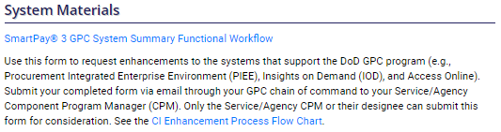
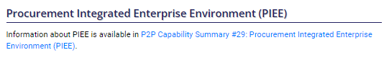
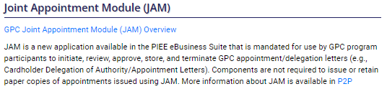
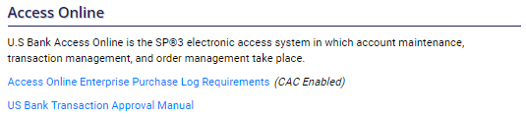
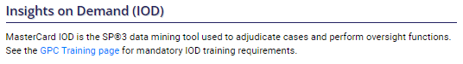
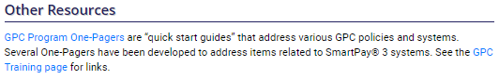
Systems Website Page
Systems Materials
Procurement Integrated Enterprise Environment (PIEE)
Joint Appointment Module (JAM)
Access Online
Insights on Demand (IOD)
Other Resources
https://www.acq.osd.mil/asda/dpc/ce/pc/systems.html

Slide 66
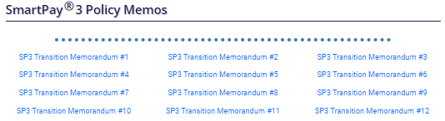
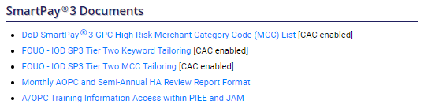
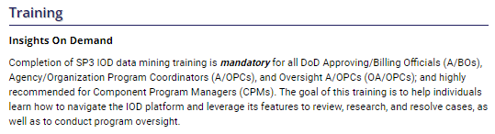
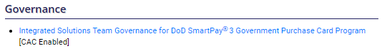
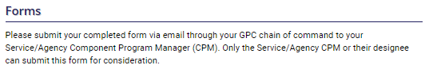
SP3 Transition Information Website Page
SP3 Policy Memos
SP3 Documents
Training
Governance
Forms
https://www.acq.osd.mil/asda/dpc/ce/pc/smart-pay.html

Slide 67
Confirmation Bias
Confirmation bias is the “tendency to interpret new evidence as confirmation of existing beliefs.” A low True Positive Rate raises the risk of confirmation bias because reviewers become used to seeing mostly False Positives. They may unconsciously assume virtually all cases are False Positives.

Slide 68
Dispute Management Update
Potential reasons for high dispute resolution in favor of merchant:
CHs dispute transactions inappropriately
CHs do not provide dispute supporting documentation to the Bank or do not provide it timely
CHs dispute transactions to cover up fraud and other suspect behavior
Improvements to dispute management will likely result in financial and other benefits to both the Government and the Bank.

Slide 69
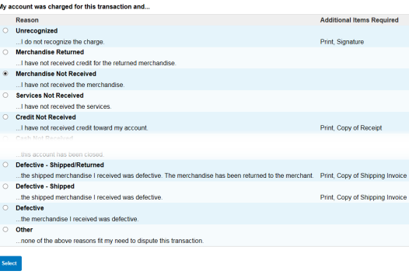
Current Dispute Process
If disputed in Access Online, the page identifies any additional documentation required based on the reason for the dispute.
Access Online images are U.S. Bank Proprietary

Slide 70
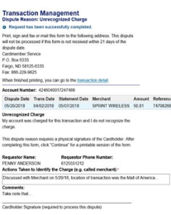
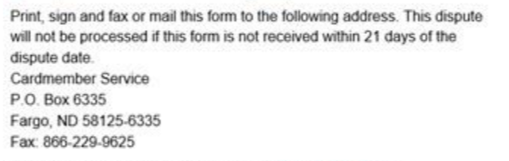
Current Dispute Process, Cont.
In addition, if disputing in Access Online, the CH MUST print, sign and fax or mail (within 21 days) the form from Access Online and the other required documentation to:
Access Online images are U.S. Bank Proprietary

Slide 71
Current Dispute Process, Cont.
The Bank will not send a communication to acknowledge receipt of the dispute, unless supporting documentation is needed. In that case, the Bank will acknowledge the dispute with a communication (email or hard copy letter) that provides a deadline for receipt of the requested information. CHs should pay close attention to the deadline and ensure the Bank receives the documents before the deadline.
Email will be the first method of communication if a valid email is associated with a CH account in Access Online Account Administration.
The email address field in Account Administration is not mandatory.
The CH email information populated within the PTQ will transfer to appropriate fields within Account Administration only if the A/OPC takes action on the task by accessing the associated account(s).
If the CH receives the request via email, the required documentation may be sent via a reply email within the timeframe specified in the email.
If a valid email is not associated with the CH account in Access Online Account Administration, communication to the CH will be sent via USPS.
If the CH receives a hard copy letter, the required documentation must be returned to the Bank in hard copy or Fax.
During the COVID-19 pandemic, the Bank developed a capability to use email, rather than paper communication, to request additional dispute documentation, when required. The Bank typically defaults to using email when a valid email address is available in Account Administration.
71

Slide 72
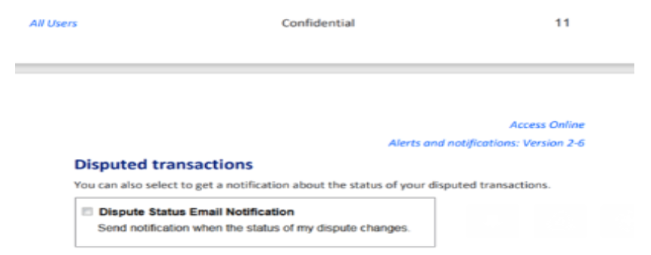
Current Dispute Process, Cont.
CHs can ensure they are notified when the status of an existing dispute changes by updating “My Personal Information” in Access Online. This may help ensure the CH is aware of whether the dispute was found in favor of the vendor or the CH.
To accomplish this, the CH must access “My Personal Information,” navigate to “Email Notifications,” and select the radio button for “Dispute Status Email Notification.”
Access Online images are U.S. Bank Proprietary

Slide 73
Current Dispute Process, Cont.
Two scenarios for dispute resolution:
The Bank does not receive the required documents within the required time:
No investigation
Determined in favor of merchant
Temporary credit is reversed (card account is charged back for the transaction)
The Bank receives the required documents within the required time:
The Bank conducts an investigation and makes a determination, either:
“In Favor of CH” – credit remains on account
“In Favor of Merchant” – credit is reversed

Slide 74
Current Dispute Process, Cont.
Full time telework may delay or fully prevent the CH from receiving mail from the Bank and makes it difficult for CH to send required documents.
CH is not in the office to get mail.
CH is not in the office to send mail or use fax machine, if available.
CH may not have access to a printer-scanner or fax machine at the telework location.
If the dispute should have been found in favor of the CH but was found in favor of the merchant because the Bank did not receive required forms or documentation, this may result in lost revenue for the Government.

Slide 75
Current Dispute Process, Cont.
Remedies:
Educate CHs:
On documentation requirements for all disputes. At a minimum, the completed form from Access Online must be sent to the Bank. Most disputes require other documents, such as receipts and shipping invoices, to be sent to the Bank.
Timeframes required by the Bank may vary. CHs need to pay close attention to dispute instructions in Access Online, and from the Bank, and comply with the requirements for each dispute.
Ensure all CH accounts have a valid email address in Account Administration. This enables the CH to receive dispute communications from the Bank via email and to send required forms/documents with an email reply.
CHs must have a valid email address recorded in Account Administration to receive dispute documentation correspondence via email.
Emphasize that if the CH does not receive an email, the dispute form and other required documentation must be sent via mail or fax to the Bank.
A/OPCs should monitor disputes frequently via Transaction Detail Report. Communicate with CH to ensure required documentation is sent within the required timeframe.
User may enable separate automated email notification for Dispute Status Changes via My Personal Information in Access Online.

Slide 76
DoD GPC Program Policy – Best Practices
Staffing Ratios
The HA should consider the number of staff needed and the required training.* Span of control ratios are established, but when sufficient compensating controls are in place, CPMs have the flexibility to override them on a case-by-case basis.**
Ensure the CPM, O A/OPC, and/or A/OPC are hired at a grade/rank that is commensurate with their responsibilities and that they have the proper motivation, skill set (including judgment and training), and leadership qualities.
Procurement authority can only be delegated by someone certified as an Acquisition Professional.
Assign the A/OPC and alternate A/OPC as a full-time position where warranted, considering the number of accounts and the span of control under their range of authority. Alternate A/OPCs must also be appointed. Consult the “Update to Governmentwide Commercial Purchase Card Span of Control Policy,” December 20, 2021 on the DPC website: https://www.acq.osd.mil/asda/dpc/ce/pc/docs-guides.html.
*See DPC GPC SP3 Transition Memo #10, dated 06/28/2019 for more information related to requirements for training, Component-level policies and procedures for use, and internal controls/oversight procedures to mitigate risks associated with CH Special Designation Authority Types other than micro-purchase authorities.
**For more information on staffing ratios, refer to earlier slides that reference Span of Control, and DPC GPC memo “Update to Governmentwide Commercial Purchase Card Span of Control Policy,” December 20, 2021.
Both memos are available at: https://www.acq.osd.mil/asda/dpc/ce/pc/docs-guides.html.
76

Slide 77
Governmentwide Commercial Purchase Card Guidance Related to Recording 889 Designation and Emergency-type Operation* Values (GPC 2022-02), June 29, 2022
Improves data integrity and promotes policy compliance by mandating use of new Access Online capability that validates CHs have made a selection from a drop-down picklist of valid values for specified purchase log fields before approval of monthly billing statements.
Expands 889 Designation List of allowable entries established in OUSD(A&S)/DPC memorandum "Recording Implementation of Section 889(a)(1)(B), Prohibition on Contracting with Entities Using Certain Telecommunications and Video Surveillance Services or Equipment, when Using the Governmentwide Commercial Purchase Card," September 9, 2020.
*See DPC GPC memorandum, “Deployment of Updated Governmentwide Commercial Purchase Card Joint Appointment Module Cardholder Special Designations (2022-01),” 5/24/22 for a definition of “Emergency-type Operations” (ETO).
77

Slide 78
Guidance on the Planned Intra-Governmental Transaction Limit Decrease Effective October 1, 2022 (2022-03)
The U.S Department of the Treasury, Card Acquiring Service issued notice that the Intra-Governmental Transaction (IGT) limit reduction from $24,999 to $10,000 went into effect on October 1, 2022.
This change necessitated redirecting IGTs exceeding $10,000 currently processed using a GPC to an alternative payment method (e.g., Intra-Governmental Payment and Collection for payments between Federal agencies, G-Invoicing, debit cards, Automated Clearing House debits/credits, and Fedwire transactions).
CPMs and A/OPCs were directed to:
Engage with their supporting Comptroller Offices to implement necessary policies and procedures to implement the IGT reduction.
Reduce existing PIEE JAM delegations of Inter/Intra-Governmental Official Cardholder Special Designation authority, as well as associated Access Online CH account single purchase limits, to $10,000 or less effective 10/01/22.
An IGT is defined as a sale of goods or services, or collection of other obligation, by one Government agency from another Government agency using a Government-issued card. Additional Information from the Department of the Treasury about the IGT change is available at https://www.fiscal.treasury.gov/cas/.
78

Slide 79
Treasury Financial Manual Update Intra-governmental Card Transaction Limit Decrease
Treasury Financial Manual References (7055-20 through 7055-60)
IGT Reduction from $24,999.99 to $10,000.00 effective October 1, 2022
Instructions for Running Reports in GPC PIEE Reporting in EDA

Slide 80
IGT Payments Threshold Reduction
Treasury Financial Manual (TFM) 7055.20 - Transaction Maximums - Effective October 1, 2022, the threshold for intra-governmental individual card transactions will decrease from $24,999.99 to $10,000.
Any individual intra-governmental card transaction greater than the outlined threshold will be rejected.
Individual transactions may not be split into two or more transactions over one or multiple days using one or multiple cards.
Federal entities must change any regulations, policies, or other procedural documents to reflect these policies.

Slide 81
IGT Payments Threshold Reduction, Cont.
TFM7055.30 – Prohibition on splitting transactions. If the customer is a Federal entity, the use of the Card for payment should be avoided. The payment method of choice for Federal entity to Federal entity transactions should be an intra-governmental payments and collection (IPAC) or G-invoicing.
TFM 7055-50 – Intra-Governmental Card Transactions.
IPAC is a way for Federal program agencies to transfer funds from one Federal entity to another using standardized descriptive data. For more details on IPAC, please follow this link: https://www.fiscal.treasury.gov/ipac/
G-Invoicing is the long-term solution for Federal Program Agencies (FPAs) to manage their intragovernmental (IGT Buy/Sell) transactions. G-invoicing helps (or will help) agencies and their training partners. For more details on G-invoicing please visit https://fiscal.treasury.gov/g-invoice/

Slide 82
Governmentwide Commercial Purchase Card Third-Party Payment and Non-Department of Defense E-Commerce Platforms Policy (GPC 2023-01)
Establishes policy for Components seeking to make purchases using non-DoD e-commerce platforms
Updates and supersedes existing DoD GPC Guidebook third-party payment requirements.* Requirements:
In no instance are CHs authorized to establish an account when using a third-party payment processor,** as doing so could require acceptance of, or agreement to, terms and conditions, or result in commitment of funds that have not been legally allocated for purchases.
Transactions using third-party payment processors are considered high-risk because:
All available transaction data may not be completely passed to the issuing bank
Use may adversely affect transaction dispute terms and processes
*Policy applies to all transactions (in-person/brick-and-mortar, and online/e-commerce platforms) involving merchants that either accept payment through, or that do not block use of, third-party payment processors.
**See Backup slides for definitions of key terms.
82

Slide 83
Definitions of Key Terms – GPC Third-Party Payment and Non-DoD E-Commerce Platforms Policy (GPC 2023-01)
For purposes of DoD GPC policy, the following definitions apply:
E-Commerce Platforms – Also referred to as e-marketplace platforms or commercial online platforms. Web-based offerings that provide a managed channel for open-market purchases. Examples of non-DoD e-commerce platforms include GSA's Commercial Platforms program (participating platforms currently include AmazonBusiness.com, FisherSci.com, and OverstockGovernment.com), and AmazonBusiness.com (separate and distinct from AmazonBusiness.com participating in the GSA's Commercial Platforms program). FedMall Marketplace is an example of a DoD e-marketplace platform.
Third-Party Payment Processors – Commercial financial service providers offering online payment solutions for commercial transactions. These processors own merchant accounts that allow them to accept and process purchase card payments on behalf of merchants who provide supplies and services. Many merchants choose to utilize third-party payment processors to accept payments without having to establish a merchant account through a merchant bank. Examples include PayPal, Venmo, Stripe, and Zelle.
Third-party E-Commerce Merchants – Third-party merchants are entities that fulfill orders on e-commerce platforms who are not the platform providers themselves. These individual merchants might offer products for sale on various online marketplaces, such as AmazonBusiness.com, and would include all FedMall Marketplace Merchants.

Slide 84
Updated Third-Party Payment Requirements
To address the risk, when selecting merchants to fulfill requirements, CHs shall use the following procedures:
Minimize use of third-party payment processors to the maximum extent practicable.
When a vendor offers the choice of using a charge card or third-party payment processor (e.g., PayPal) at checkout, use the charge card.
When considering a vendor that requires use of a third-party payment processor, take action to find a merchant that does not use a third-party payment processor.
If the only reasonable source is a vendor that requires use of a third-party payment processor, ensure adequate supporting documentation is stored in Access Online's Transaction Management - Attachments to show that a detailed pre-purchase review was completed and that use of the vendor was unavoidable.

Slide 85
Updated Third-Party Payment Requirements, Cont.
Additionally, CPMs must ensure CH are:
Appropriately trained on DoD GPC Third-Party Payment Policy; DoD GPC Policy for Non-DoD E-Commerce Platforms; related Component policy; and third-party payment processor requirements and risks in: OMB Circular A-123, Appendix B; and GSA Smart Bulletin No. 023 entitled “GSA SmartPay - Third Party Payment Processors.”
Never authorized to establish an account when using third-party payment services for processing GPC payments.
To validate policy compliance, CPMs may consider requiring that A/OPCs periodically identify transactions using third-party payment services by using the Access Online Transaction Detail Report and including a summary of the review in the "Comments" field of the SAHAR.
To identify transactions that may have been made using a third-party payment processor, see the slide entitled Updated Third-Party Payment Requirements – Best Practices in the Backup slides for best practice recommendations.
85

Slide 86
DoD GPC Policy on Non-DoD E-Commerce Platforms
Third-party payment policy does not apply to transactions on e-commerce platforms or brick-and-mortar merchants that do not accept payment through, or that block DoD use of, third-party payment processors. When shopping/ordering through these e-commerce platforms, CHs do not need to worry about third-party payment services. This includes:
E-commerce platforms in GSA's Commercial Platforms program*
Provides a managed channel for micro-purchases through select commercial platforms; currently includes AmazonBusiness.com, FisherSci.com, and OverstockGovernment.com
AmazonBusiness.com (distinct from AmazonBusiness.com participating in GSA's Commercial Platforms program)
Additional e-commerce platforms that meet the criterion in the future
Payment practices may change at any time, therefore, if your organization chooses to authorize/implement use of e-commerce platforms, CPMs need to issue Component-level policy to:
Validate at least semi-annually that each applicable e-commerce platform continues to meet the criterion
Following the completion of each re-validation, if an e-commerce platform no longer meets the criterion
Notify GPC oversight personnel and CHs
Mandate that CHs comply with DoD and Component third-party payment policy for the applicable platform
86
*As this is a relatively new initiative, DPC approval is required in advance of Component participation.

Slide 87
Prohibition on Use of the Governmentwide Commercial Purchase Card When Contracts Contain Federal Acquisition Regulation Clause 52.229.12, Tax on Certain Foreign Procurements (2023-02)*​
The policy change applies to GPC CHs using Contract Ordering Official and/or Payment Official JAM authorities above the simplified acquisition threshold. This prohibition does not apply to micro-purchasing.** ​
Defense Federal Acquisition Regulation Supplement (DFARS) Case 2021-D029, “Reporting Tax Information on Certain Foreign Procurements,” published 10/28/22, updated DFARS 213.301 for an additional process related to FAR clause 52.229-12, "Tax on Certain Foreign Procurements," requiring an update to GPC policy.
GPC CHs shall not use the GPC as a method of payment or purchase when a contract instrument contains FAR clause 52.229.12, unless DFARS clause 252.229-7014, "Full Exemption from Two Percent Excise Tax on Certain Foreign Procurements" is also present.
*Memo 2023-02 supersedes in full OUSD(A&S)/DPC memorandum, "GPC Interim Use Prohibition When Contracts Contain Federal Acquisition Regulation Clause 52.229-12 – Tax on Certain Foreign Procurements (GPC 2021-2)," 11/5/21.
**In certain circumstances, the Government must withhold a two-percent excise tax on foreign payments to vendors to comply with the FAR and Internal Revenue Service regulations. This prohibition is required because the GPC does not provide a method to accomplish this withholding.
87

Slide 88
Prohibition on Use of the Governmentwide Commercial Purchase Card When Contracts Contain Federal Acquisition Regulation Clause 52.229.12, Tax on Certain Foreign Procurements (2023-02), Cont. ​
Under the updated DFARS subpart 213.301, the GPC is prohibited from being used as a method of:
Purchase and payment to place a task order or delivery order under any federal contract or blanket purchase agreement (BPA) issued under FAR part 8 procedures when the contract or BPA includes FAR clause 52.229-12, but does not include DFARS clause 252.229-7014;
Purchase and payment when a task order, delivery order, or call order under any federal basic ordering agreement or BPA issued under FAR part 13 procedures, when the resulting order would include FAR clause 52.229-12 but not DFARS clause 252.229-7014; or
Payment when a contract or order includes FAR clause 52.229-12 but not DFARS clause 252.229-7014.

Slide 89
Governmentwide Commercial Purchase Card Prohibited Purchases (GPC 2023-03)
Consistent with DFARS Class Deviation–Prohibition on Procurement of Certain Items Containing Perfluorooctane Sulfonate (PFOS) or Perfluorooctanoic Acid (PFOA), DARS Tracking Number 2022-O0010, Revision 1, dated 12/23/22, this memo adds the following “covered items” identified in DFARS 252.223-7998 to the GPC prohibited purchase list:
Nonstick cookware or cooking utensils for use in galleys or dining facilities
Upholstered furniture, carpets, and rugs treated with stain-resistant coatings
Implements FY21 NDAA (Pub.L. 116-283) effective 4/1/23
Applies to GPC open-market micro-purchases
Advises Components to issue guidance for use of other GPC Special Designations to promote compliance, such as:
Inter/Intra-Governmental Transaction CHs to requisition similar items from stock;
GPC Contract Ordering Official CHs directed to DFARS-compliant indefinite delivery, indefinite quantity contracts (IDIQs); blanket purchase agreements (BPAs); and blanket ordering agreements (BOAs);
Or directing CHs to coordinate requirements for covered items that might contain PFOS or PFOA with their supporting contracting office.
Memo attachment provides a list of EPA resources available for use when developing Component policy.

Slide 90
Per- and Polyfluoroalkyl Substances
Per-and Polyfluoroalkyl Substances (PFAS) are a group of manufactured chemicals that have been used in industry and consumer products since the 1940s because of their useful properties.
There are thousands of different PFAS, some of which have been more widely used and studied than others.
PFOA and PFOS are two of the most widely used and studied chemicals in the PFAS group. PFOA and PFOS have been replaced in the U.S with other PFAS in recent years.
One common characteristic of concern regarding PFAS is that many break down very slowly and can build up in people, animals, and the environment over time.
Current scientific research suggests that exposure to high levels of certain PFAS may lead to adverse health outcomes.

Slide 91
Updated Third-Party Payment Requirements – Best Practices
Best Practice: To identify transactions that may have been made using a third-party payment processor:
Run the Transaction Detail Report in Access Online.
Sort the report by merchant name.
Look for merchant names where an asterisk precedes the merchant name.
Review the resulting list and remove transactions that were not made using a third-party payment processor (i.e., do not begin with an asterisk).
The transactions that remain on the list have a high probability of having been made using a third-party payment processor.
Note: Merchants may include an asterisk for reasons other than using a third-party-payment processor for the transaction. For example, an asterisk may indicate that there is more information available on the statement to identify the transaction (e.g., order number or reference number).

Slide 92
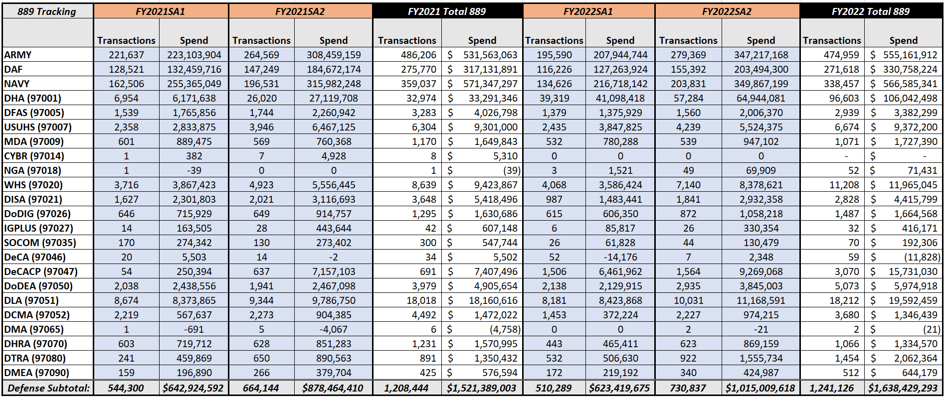
U.S. Bank 889 Reporting Data (FY21 and FY22)
889 – All Services/Defense Agencies with 889 transactions - (FY21 & FY22)
Observations:
889 purchase log recording increasing due to 2022 TM improvement
Planned 2023 OM improvement will result in significant further 889 recording increase
Requirement:
Continue recording 889 designation for all transactions.
889 GPC Reporting Requirements: See memos entitled “Governmentwide Commercial Purchase Card Guidance Related to Recording 889 Designation and Emergency-type Operation Values (GPC 2022-02),” 6/29/22, and “Recording Implementation of Section 889(a)(1)(B), Prohibition on Contracting with Entities Using Certain Telecommunications and Video Surveillance Services or Equipment, when using the Governmentwide Commercial Purchase Card,” 9/9/20. 6/29/22 memo updated Allowable Purchase Log Designations updated.
Allowable Purchase Log Designations: 889 Merchant Rep; 889 ODNI; 889 Exception; 889 Payment (IGT/Contract/SF182); 889 Non-compliant; Fraudulent (external Transactions); Disputed Transactions; Fees (e.g., Convenience Check); Refunds & Trans Credits/Discounts; Memo for Record approved by A/OPC.

Slide 93
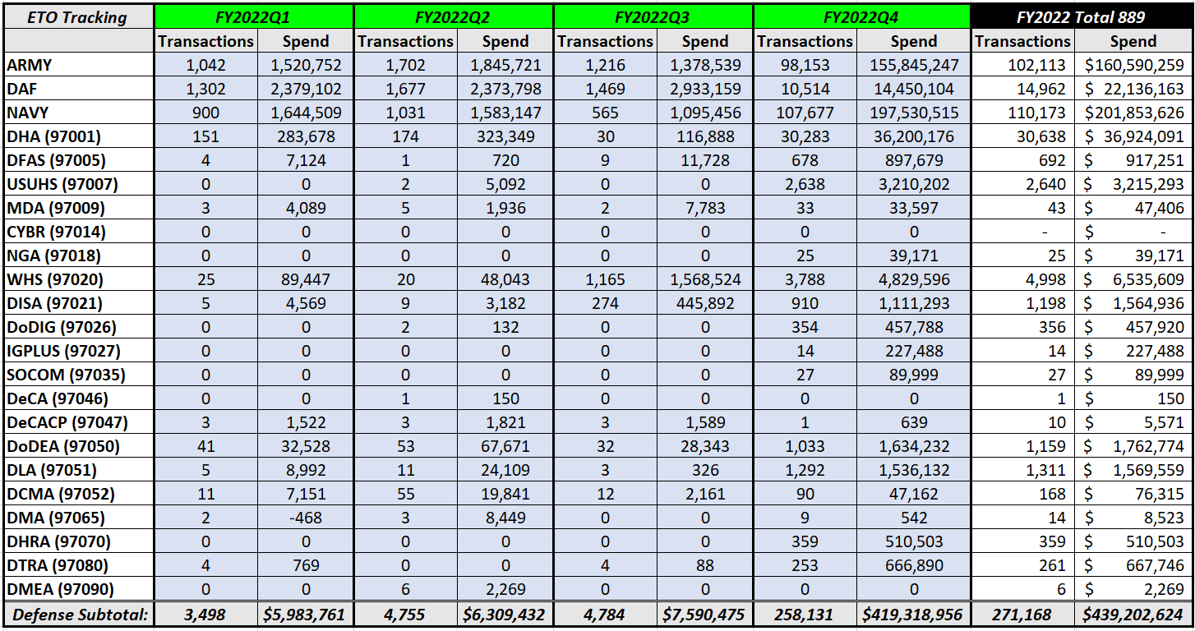
U.S. Bank Emergency Type Operations (ETO) Reporting Data (FY 2022)
ETO – All Services/Defense Agencies with 889 transactions - (FY2022)
Observations:
ETO recording increased significantly in Q4 due to 7/1/2022 TM improvement
Planned 2023 OM improvement will result in significant further ETO recording increase
Requirements:
Continue recording purchase log entries for all transactions that have a NIA Code.
Continue recording appropriate ETO drop-down entries for all transactions in TM.
Following implementation of CI 225 and accompanying policy has been put in place, begin recording appropriate ETO drop-down entries for all transactions in OM.
ETO Memoranda: “Governmentwide Commercial Purchase Card Guidance Related to Recording 889 Designation and Emergency-type Operation Values (GPC 2022-02),” 6/29/22, “Governmentwide Commercial Purchase Card Guidance Related to Recording Transactions involving National Interest Action Codes and Emergency Acquisition Authorities (GPC 2021-1),” 12/9/20, and “Department of Defense SmartPay® 3 Government-wide Commercial Purchase Card Guidance for the Coronavirus Disease 2019 (COVID-19),” 4/2/20. As addressed in 889 slides, once the capability exists in OM, a GPC memo will be issued establishing required Purchase Log Standard Operating Procedures in OM that will include ETO drop-down selections.
Allowable Purchase Log Designations: Not in support of ETO; Applicable code not in this list; O14S-Operations in Iraq and Syria; O15F Operation Freedom’s Sentinel; O21R Operation Allies RefugeWelcome
93

Slide 94
Section 889(a)(1) and ETO Purchase Log Requirements and Policy Compliance
Implemented/Planned Access Online Functionality to Improve 889 and ETO Purchase Log Data Capture
FY22Q3 – TM – Enabled Transaction Custom Fields with dropdown lists – COMPLETED SUCCESSFULLY on 7/1/2022
889 Requirement and Compliance:*
CHs required to record 889 purchase log designations for all purchase card transactions.
FY22 Total DoD spend of $4.97B (3.7MM transactions), compared to only $1.64B (1.24MM transactions) with an 889 purchase log entry. This represents a significant policy non-compliance: only 32.97% of transactions included a valid 889 entry.
ETO Requirement and Compliance:*
CHs required to record a National Interest Action Code in the purchase log for all ETO transactions for which one exists.
CHs required to enter an ETO purchase log entry for all transactions made in TM, using drop-down capabilities.
FY22Q4 Total DoD spend of $1.72B (1.08MM transactions), compared to $419.3MM (258K transactions) that recorded an ETO purchase log entry. 24.3% of transactions included a valid ETO entry.
FY23/24 – OM – CI 225 – Updating Custom Fields – PENDING
Drop-down lists to replace free-form text fields for 889 and ETO entries and require a valid value entry from the drop-down list.
Drop-down lists will require CH to change the “blank” to a valid value from the list in order to save Order Record.
DPC anticipates significant improvement once this capability is deployed.
Once CI implemented, policy to be updated to require CHs to select an ETO purchase log entry from drop-down picklists for all transactions.
*See slides 27 and 28 for a detailed discussion of 889 and ETO purchase log requirements. FY22 ETO and 889 spend data is displayed on slides 92 and 93. Note: This slide and associated data appearing above address only compliance with 889 and ETO purchase log policy requirements.
94

Slide 95
Backup Summary
This section contains detailed instructions on how to run and compare the JAM GPC Training Report and the Access Online System User List Report to answer the following questions:
Are all individuals current with their training?
Do all Access Online accounts have JAM appointments?
Have all JAM appointments been terminated when Access Online accounts were terminated?

Slide 96
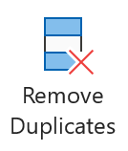
Running the JAM GPC Training Report
Login to PIEE, select the EDA icon, select JAM Reports, and then select JAM GPC Training Report.
Use the JAM GPC Training Report Search Criteria screen to define the parameters for your report.
Ensure “Show Current Training” is checked, as it will provide the latest training (removes old duplicate training).
Select “Search” to display results in EDA.
If the amount of data requested is large, you will need to wait while the report is prepared.
When viewing the report in EDA, only a few summary data elements display, and results are limited to 10,000 records.
It is best to download the search results, especially for large data sets.
Download the JAM GPC Training Report and load the resulting CSV file into Excel. This is the JAM GPC Training Report workbook that will be used for the steps on the following slides.
Remove any duplicates so you have a shorter report to compare to the Access Online System User List Report (see next slide):
In Excel, click on “Data” followed by “Remove Duplicates” from the ribbon.
From the Remove Duplicates dialog box that displays, remove duplicates based on “Appointment First Name,” “Appointment Last Name,” and “Appointment (Work Email Address).” A message will display stating how many duplicate values were found and removed, and how many unique values remain.
Rename the tab to “JAM” by double-clicking the tab at the bottom of the file; save your work.
Note: Use Save As to save the spreadsheet in the Excel format as CSV format does not allow for multiple tabs.

Slide 97
Running the Access Online System User List Report
Run the System User List Report:
Log into Access Online
Click on Reporting>Administration>System User List
Select the Report type “Detail”
Leave the Date range blank
Select the “Active” User Status
Under “Additional Details,” select “Contact Information” and “DoDAAC Details”
Under “Group Reports By,” select “Reporting Hierarchy Position” and identify your hierarchy
Click “Run Report”
Remove any duplicates so you have a shorter report to compare to the JAM GPC Training Report:
In Excel, click on “Data” followed by “Remove Duplicates” from the ribbon.
From the Remove Duplicates dialog box that displays, remove duplicates based on “User ID,” “Functional Entitlement Group,” and “Email Address.” A message will display stating how many duplicate values were found and removed and how many unique values remain.

Slide 98
Comparing the Two Reports
Copy the AO System User List Report into the JAM GPC Training Report workbook :
Open the JAM GPC Training Report workbook created with the directions on the previous slides.
Open the AO System User List Report file, right-click the tab at the bottom of the file, and select “Move or Copy.” In the “Move or Copy” dialog box, select the JAM GPC Training Report workbook in the “To book:” drop-down and select “Create a copy.”
In the JAM GPC Training Report Excel workbook, rename the new tab “AO” by double-clicking on the tab.
Use the email address to compare the resulting records in the AO System User List Report and the JAM GPC Training Report in the JAM GPC Training Report workbook. Directions for making the comparison are provided on the slides that follow.
Note: CeB plans to implement new EDA reports that will allow for easier matching of users, appointments, abbreviated training data, and accounts in the near future.

Slide 99
How to Compare the Data to Answer Questions
Steps to determine a) whether all individuals are current with their training, and b) whether all individuals with an appointment have an Access Online account:
On the JAM tab of the JAM GPC Training Report workbook:
Insert 3 columns to the very left of the existing data by highlighting existing columns A+B+C, right-clicking anywhere on the selected columns, and then selecting “Insert” from the menu that displays.
Add a formula to the newly added column A to look for a match on each email address in column E of the AO tab (will become column F once steps on the AO slide are completed). (Use formula 1 on the next slide)
Add a formula to the newly added column B to determine whether the latest training due date is in the past for the program participant. (Use formula 2 on the next slide)
Add a formula to the newly added column C to identify the training for which the training date has elapsed for the program participant. (Use formula 3 on the next slide)
Tips:
Be sure to apply the formulas all the way down your data set. You can do this by dragging the small black box that appears on the bottom right of the cell in which you entered the formula.
If you have a large data set, it may take some time for formulas to calculate and to save the file.
It is a best practice to track training weekly.

Slide 100
How to Compare the Data to Answer Questions, Cont.
Partial snapshot of the JAM tab in the workbook once new columns and formulas are inserted:
A
B
C
AO Name | Latest Training Due Date in past? | Latest Training Due Date | Appointment First Name | Appointment Last Name | Appointment (Work Email Address)
Aarsand, Erik | !Overdue-- | 9/29/2022 | Erik | Aarsand | erik.t.aarsand.mil@army.mil
Aarsand, Erik | !Overdue-- | 10/23/2022 | Erik | Aarsand | erik.t.aarsand.mil@army.mil
Formula 1 for column A: =XLOOKUP(F2,AO!$T$3:$T$11,AO!$C$3:$C$11,"!Missing--")
If you see “!Missing--” no account for the individual exists in Access Online.
Formula 2 for column B: =IF(MAX(IF((F:F=F2)*(V:V=V2),Z:Z))<TODAY(),"!Overdue--","No")
If you see “!Overdue--” the individual’s training is overdue for a given course. Otherwise, the training is not overdue. Note: CLG001 is not the same as CLG0010.
Formula 3 for column C: =MAX(IF((F:F=F2)*(V:V=V2),Z:Z))
Identifies the date of the course that is overdue.
Note: If the date is not displayed as seen above, please select the column and change the cell format to Date by right clicking the highlighted column and selecting format cells.

Slide 101
How to Compare the Data to Answer Questions, Cont.
Steps to determine a) whether all individuals with an Access Online account have an appointment and b) whether their training is current:
On the AO tab of the JAM GPC Training Report workbook you created previously, insert 1 column to the very left of the existing data by highlighting existing column A, right-clicking, and selecting “Insert.”
Be sure to apply the formulas all the way down your dataset. You can do this by dragging the small black box that appears on the bottom right of the cell in which you entered the first formula.
Formula for column A: =IF(XLOOKUP(T2,JAM!F:F,JAM!B:B)="!Overdue--","!Overdue--","Current")
If you see “!Overdue--” then at least one training is overdue. “Current” indicates that all training for the user is current.
If you see “#N/A” the appointment for the user, based on the email address in Access Online, was not found in the JAM data.

Slide 102
JAM Enhancement Summary
Enhancement | Summary
Reuse Appointment Data or Expand Access | Allow original initiator, other O A/OPCs, and A/OPCs at the same role location DoDAAC or Group to re-initiate an appointment using details from an appointment that was initiated but never fully approved. Allow O A/OPCs and A/OPCs to delete nominations within their span of control. Only restriction would be if nomination resulted in an active appointment.
Automatic Access Granted Based on GPC Role | Automatically grant the EDA Advance Reporting role to all current and new CPMs, O A/OPCs, A/OPCs, Delegating/Appointing Authorities (DAAs), Appointing Authorities (AAs), Component Resource Managers (RMs), and Oversight RMs.
Training Data | If refresher training has not been taken timely, allow the O A/OPC and A/OPC who can see the appointment to archive the role.
Reporting | Display the reason for inactivation in EDA reporting. Electronic signatures to include Electronic Data Interchange (EDI) appointments and DD Form 577s.
Bulk Appointment Updates | Create an area in JAM for CPMs, O A/OPCs, and A/OPCs to enter role specific text for use in all appointments: Allow the O A/OPC and A/OPC to make bulk changes by Appointment type. Allow Mass Update of Appointments.
Other | Allow O A/OPCs to make administrative changes to appointments without requiring the full workflow. Add a full Appointment History section to the appointment and letter; create a new section on the appointment that captures all changes for the appointment.

Slide 103
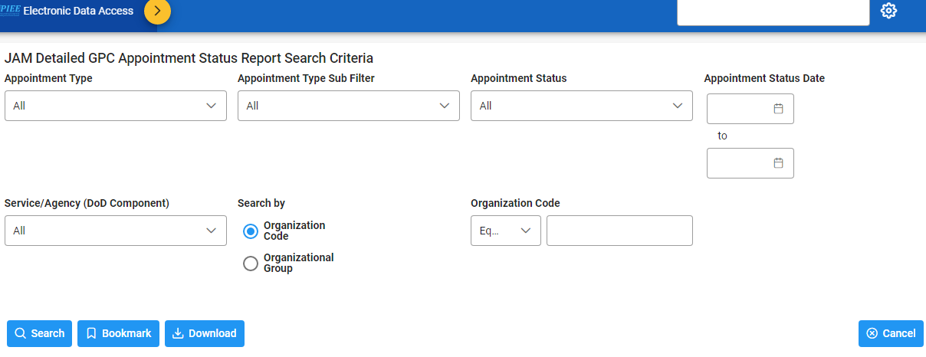
JAM Detailed GPC Appointment Status Report
Can search on:
Appointment Type | Dates
Appointment Sub-Type = Special Delegation | Organization
Appointment Status

Slide 104
Automated JAM Appointment Clean Up
ACTION: To prevent auto-termination of necessary appointments when the process is run, A/OPCs must ensure all individuals in their program who need to retain their JAM appointments: a) work with their GAMs to reactivate their PIEE account, and b) keep their PIEE accounts ACTIVE (e.g., use the PIEE Access Online Single Sign On). The following resources and procedures may be used:
Review the attached PIEE Auto-terminated Appointments List
A/OPCs can use the Appointment Initiator Details, Group and Role Location (DoDAAC) columns to find appointments for their span of control.
The GAM’s email address is also provided to allow for viewing the data by GAM.
Run an Access Online System User List Report
Compare the reports to identify active Access Online users whose appointments were terminated
Direct those users (email addresses included on PIEE report) to follow the steps on the next slide and in the PIEE User Account Reactivation Process Reference Guide at https://pieetraining.eb.mil/wbt/portal/documents/User_Account_Reactivation_Process.pdf to reactivate their PIEE account.

Slide 105
Automated JAM Appointment Clean Up, Cont.
FAQ: Some of my PIEE user roles have been systemically set to inactive or archived. How can I have my roles reactivated?
Answer: Logon to PIEE (https://piee.eb.mil). If you do not have any active roles, you will be required to click the “Reactivate or Add Roles” button and follow the screens until you successfully complete the reactivation process.
If you have some active roles and wish to reactive a role that is currently inactive / archived, click the “My Account” button, then click on the “Manage Roles” section, select the checkbox of each role, click the “Request Activation” button, and complete the reactivation process.
Once the “Request Activation” process is completed, an approval email will be sent to the Supervisor/Sponsor identified on your Profile. After Supervisor/Sponsor approval, the PIEE GAM will activate the role(s). Additional information is available in the attached power point presentation.
Please email any questions to: DODPCPO@sterlingheritage.com

Slide 106
Other PIEE Enhancements
Enhancements were deployed to streamline the PIEE Account Reactivation process
In a single workflow, a user can request reactivation of archived roles and/or addition of new roles
GAMs can tailor their account notifications to areas of responsibility
PIEE / FedMall SSO was deployed
The FedMall icon was enabled for all JAM appointed CHs
Existing FedMall users’ information was migrated
PIEE data is used to streamline FedMall Account Set Up for new users
The JAM Detailed GPC Appointment Status Report was enhanced
The ability to search by nominator’s Location/Group was added

Slide 107
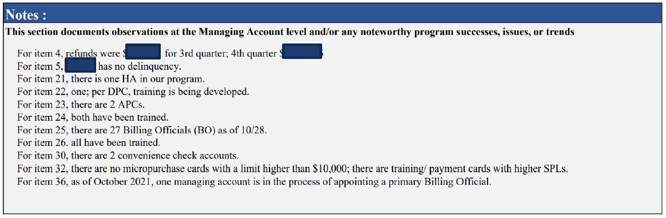
Best Practice from a SAHAR Submission
The detailed notes show the CPM is tracking important metrics and internal controls related to refunds, delinquencies, and number of folks in each role and whether they are trained, even though this information does not auto-populate.

Slide 108

GSA Starmark Logo

